Slide 1
PERSONAL MONTHLY PROJECT:
OUR Team MEMBERS nAME:
First member nAME: Ali cHANdiO
Second member namE: nABEEL AHMED
THIRD MEMBER nAME: dANISH Ansari
FOURTH member nAME:
OUR Team MEMBERS cHALAN nO:
First member CHALAN nO: 258938
Second member CHALAN nO: 258937
THIRD MEMBER CHALAN nO: 258910
FOURTH member CHALAN nO:

Slide 2
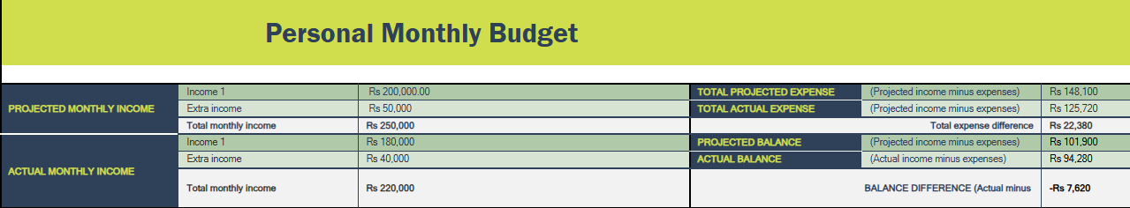
OUR IDEA:
Comparison of Income: It shows both projected (expected) and actual monthly income, including income from primary sources and extra sources.
Expense and Balance Analysis: It compares projected expenses with actual expenses and calculates the differences, highlighting overspending or savings.
Balance Difference: It calculates the overall balance difference (actual vs. projected) to show whether the budget is on track or needs adjustment.

Slide 3
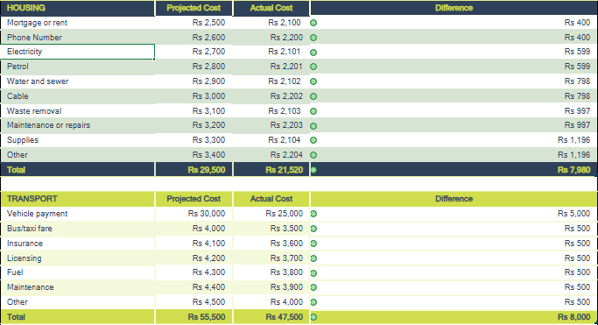
EXPLINATION OF TABLES
Category-Wise Cost Tracking: It separates expenses into Housing (e.g., rent, electricity, maintenance) and Transport (e.g., vehicle payments, fuel, bus fares).
Projected vs. Actual Costs: It highlights differences between planned (projected) and actual spending for each item.
Overall Differences: It calculates total over- or under-spending in both categories, helping identify areas where adjustments are needed.

Slide 4
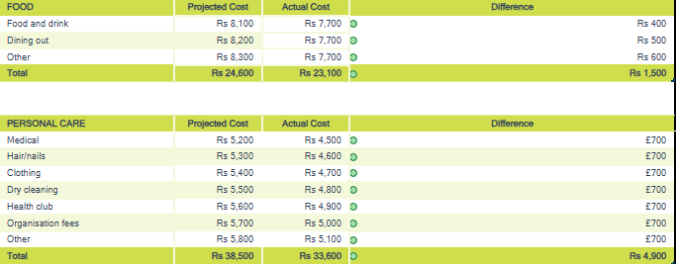
EXPLINATION OF TABLE
Expense Breakdown: It categorizes spending into Food (e.g., food & drink, dining out) and Personal Care (e.g., medical, clothing, haircare).
Projected vs. Actual Comparison: It shows planned (projected) and actual spending for each item, identifying variances.
Total Differences: It calculates overall savings or overages in each category, helping analyze spending habits.

Slide 5

THANK YOU FOR WATCHING

